Slide 1
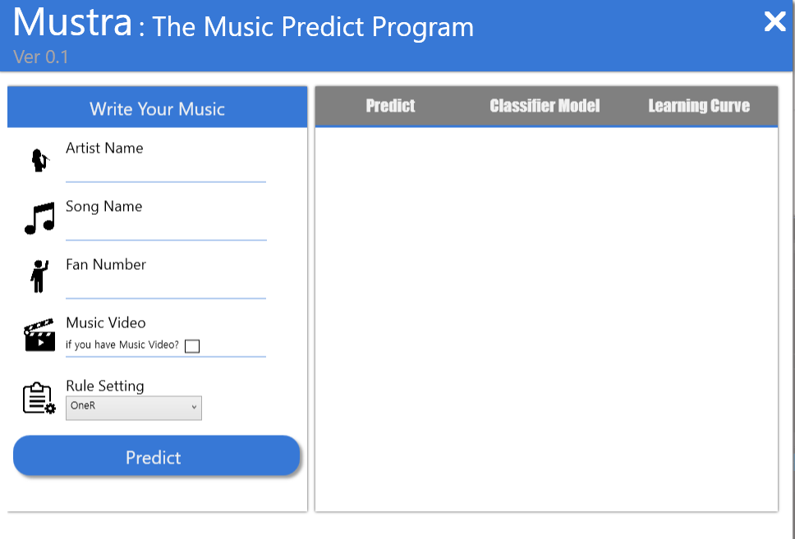

DataMining
Mustra
201521107 이정환
201520700 신다민
201720399 김효빈
https://mustra-fan.github.io/

Slide 2
Index
01
02
03
04
About Domain
Analysis
Demo
Q & A
Project Name
Pre-Processing
Attributes
Learning Curve
True Performance
ANOVA Test
Home Page
WPF GUI
Q & A

Slide 3
About Domain
MUSTRA
About Domain

Slide 4
Project Name
MUSTRA
Music + Nostradamus
“
Mustra

Slide 5

Pre-Processing
MUSTRA
“
Melon Page
Google Page
Web Crawling

Slide 6

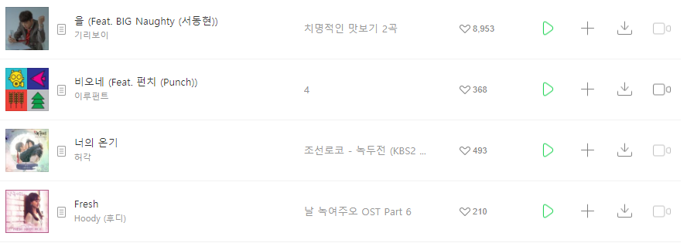
Pre-Processing
MUSTRA
[ 최신곡 ]
좋아요 수

Slide 7

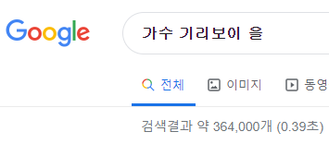
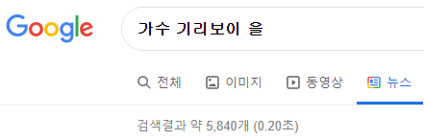
Pre-Processing
MUSTRA
Web Crawling
가수 이름 검색 수
가수 + 노래제목 검색 수
가수 + 노래제목 검색 기사 수

Slide 8
Attributes
MUSTRA
Attributes
Attribute Name | Name | Value
ASR | 가수 검색 결과 수 | Numeric
ASSR | 가수 + 노래 검색 결과 수 | Numeric
ASSNR | 가수 + 노래 기사 수 | Numeric
Video | 뮤직 비디오 유,무 | Nominal
FanNum | 멜론 팬 수 | Numeric
LikeC (Class) | 좋아요 수 | Nominal
Range
Numeric
Numeric
Numeric
Yes or No
Numeric
{ A, B, C, D }

Slide 9



Attributes
MUSTRA
Class
Attribute Name | Name | Value
LikeC (Class) | 좋아요 수 | Nominal
Range
{ A, B, C, D }
Value | Range
A | 20000 <= X
B | 10000 <= X < 20000
C | 1000 <= X < 10000
D | X< 1000

Slide 10
Attributes
MUSTRA
User Input
SingerName
Attribute Name | Name | Value
SingerName | 가수 이름 | Nominal
SongName | 노래 제목 | Nominal
FanNum | 멜론 팬 수 | Numeric
Video | 뮤직 비디오 유,무 | Nominal
SongName
FanNum
Video

Slide 11
Attributes
MUSTRA
WHY?

Slide 12

Attributes
MUSTRA
Input Data
Server
New Instance
Web
Crawling
ASR
SingerName
ASSR
SongName
ASSNR
FanNum
FanNum
Video
Video

Slide 13
Analysis
MUSTRA
Analysis

Slide 14

Learning Curve
MUSTRA
“
509개의 Dataset
-> 51개씩 분할
Weka
Training data set
10개의 Dataset 생성
Machine
Learning
Output
Knowledge

Slide 15
Learning Curve
MUSTRA
“
Weka
Training data set
Machine
Learning
1. Naïve Bayes
2. OneR
3. Decision Tree
Output
Knowledge

Slide 16
Learning Curve
MUSTRA
“
Weka
Training data set
Machine
Learning
Output
Knowledge
Algorithm별 정확도 측정

Slide 17
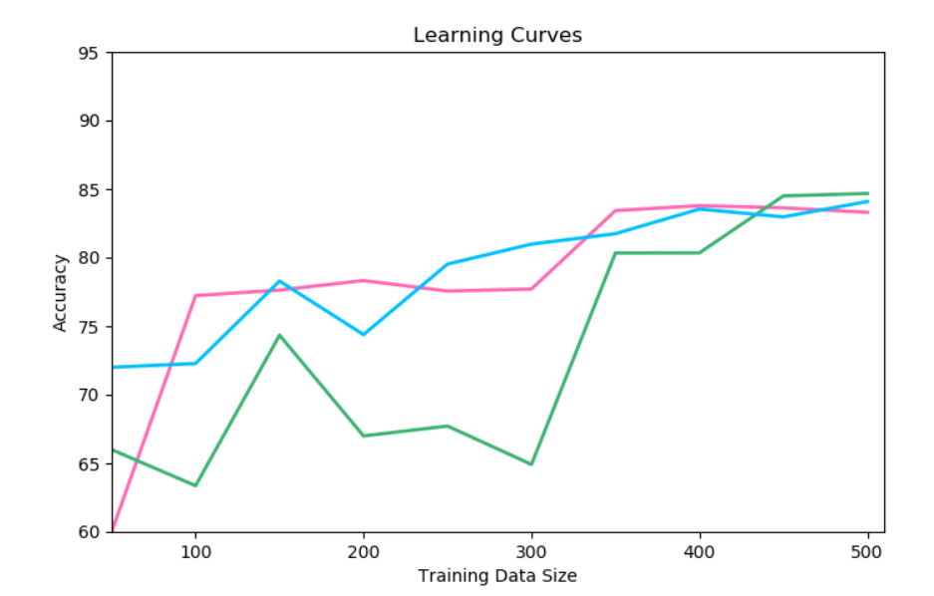
Learning Curve
MUSTRA
80%
85%
Naïve Bayes
84.675%
OneR
84.086%
Decision Tree
83.783%
Decision Tree
Naïve Bayes
OneR

Slide 18
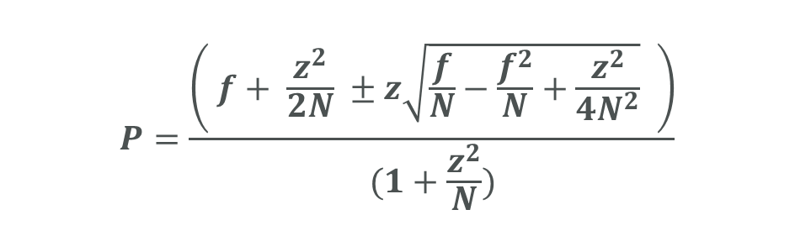
True Performance
MUSTRA
“
$$P=\frac{\left( f+ \frac{z^{2}}{2N} ±z\sqrt{\frac{f}{N}−\frac{f^{2}}{N}+\frac{z^{2}}{4N^{2}}} \right)}{(1+\frac{z^{2}}{N})}$$
신뢰도에 따른 P의 범위
N = Instance의 개수
Z = 신뢰도 값에 따른 정규분포
C = 80% -> z = 1.28
C = 90% -> z = 1.65
f = 해당 algorithm의 정확도

Slide 19
True Performance
MUSTRA
C = 80% -> z = 1.28
 | Value | P값 범위
OneR | f = 84.086 | 79.769% < P < 88.181%
 | Z = 1.28
 | N = 509
Naïve Bayes | f = 84.675 | 80.371% < P < 88.725%
 | Z = 1.28
 | N = 509
Decision Tree | f = 83.783 | 78.938% < P < 88.353%
 | Z = 1.28
 | N = 408

Slide 20
True Performance
MUSTRA
C = 90% -> z = 1.65
 | Value | P값 범위
OneR | f = 84.086 | 77.278% < P < 90.525%
 | Z = 1.65
 | N = 509
Naïve Bayes | f = 84.675 | 80.005% < P < 93.097%
 | Z = 1.65
 | N = 509
Decision Tree | f = 83.783 | 76.150% < P < 90.959%
 | Z = 1.65
 | N = 408

Slide 21
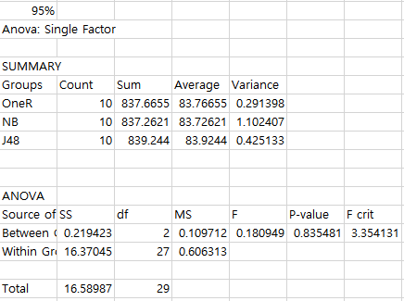
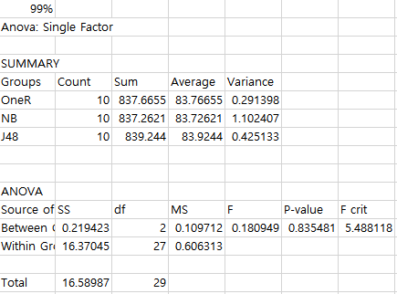
ANOVA Test
MUSTRA
“
ANOVA - Single Factor
해당 Instance 번호 ±1개씩
10개의 Dataset 생성

Slide 22
ANOVA Test
MUSTRA
OneR
Naïve Bayes
Decision Tree
Instance Number | Accuracy (%)
500 | 84
501 | 83.832
502 | 83.864
503 | 84.095
504 | 83.531
505 | 84.158
506 | 82.411
507 | 84.220
508 | 83.464
509 | 84.086
Instance Number | Accuracy (%)
500 | 84.8
501 | 83.632
502 | 83.864
503 | 83.697
504 | 81.547
505 | 84.356
506 | 83.201
507 | 82.643
508 | 84.842
509 | 84.675
Instance Number | Accuracy (%)
404 | 82.630
405 | 84.653
406 | 83.950
407 | 83.251
408 | 83.783
409 | 83.578
410 | 84.596
411 | 84.634
412 | 84.184
413 | 83.300

Slide 23
ANOVA Test
MUSTRA
95%
Sum = 837.665
Average = 83.766
Variance = 0.2913
F비 -> 0.18094
F기각치 -> 3.3541
F
OneR
05,2,27
ANOVA
Naïve
Bayes
Sum = 837.262
Average = 83.726
Variance = 1.1024
99%
F
Decision
Tree
F비 -> 0.18094
F기각치 -> 5.4881
01,2,27
Sum = 839.244
Average = 83.924
Variance = 0.4251

Slide 24
Demo
MUSTRA
Demo

Slide 25




Demo
MUSTRA
Mustra
Server
Send Data
Input
Output
Output
Crawling
Get Data
Crawling

Slide 26



Demo
MUSTRA
“
Java
Training data set
Machine
Learning
Output
Knowledge

Slide 27

Demo
MUSTRA
“
Python
Training data set
Machine
Learning
Output
Knowledge

Slide 28
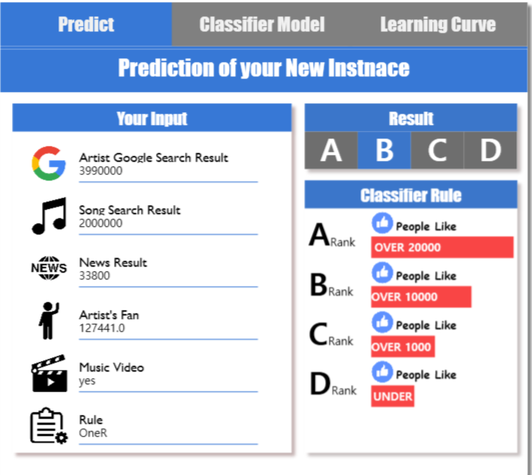

Demo
MUSTRA
“
C# - wpf
New instance
Knowledge
Based
Predict

Slide 29


Demo
MUSTRA
MUSTRA
https://mustra-fan.github.io/
https://github/mustra-fan.github.io/

Slide 30
Q & A
MUSTRA
Q
A
&

